Slide 1




Week 4
User Experience: Scope
COM4012M Programming 02
1

Slide 2
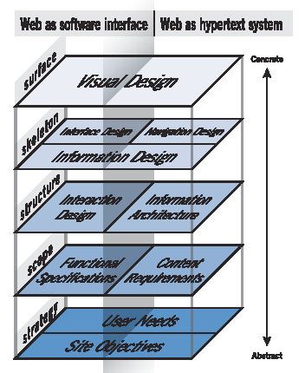
UX Design - Scope
Source: Garrett, 2002
2

Slide 3
Describes how a product will work entirely from the user's perspective. It talks about features. It specifies screens, menus, dialogs, and so on.
It is an evolutionary document that will change dramatically during the planning phase of a project. It should also be kept up to date when additional functionality is implemented, throughout the whole project.
What is a functional spec?
In an ideal world, a complete functional spec should leave no questions unanswered or anything open to interpretation about the functionality of the application.
4

Slide 4
Accurate Estimations: Provides precise requirements, enabling programmers to estimate time, resources, and costs effectively.
Focused Development: Allows programmers to concentrate on coding rather than deciphering business logic, boosting productivity.
Why have a functional spec?
Testing Framework: Serves as a basis for creating a test plan, ensuring that all functionalities are validated post-development.
Expectation Alignment: Aligns client and developer expectations on functionality, reducing risks of misunderstandings.
Facilitating Collaborative Development: A well-documented functional specification enables multiple programmers to work on different components of the application concurrently, promoting collaboration and efficiency while minimizing integration issues later on.
5

Slide 5
Anything to do with business strategy, such as marketing, competitor analysis, metrics etc.
Anything to do with the visitors’ equipment, including their browser, connection speed, screen resolution, installed plug-ins, etc.
What should a functional spec NOT contain?
Anything to do with the visual design and the tone and imagery that the site should take on.
Anything to do with any static content that the site will contain either added manually by the developer or by the client using a Content Management System.
Anything to do with the internal implementation of the application, such as data structures and algorithms, etc.
Anything to do with the site structure, navigation, and layout.

Slide 6
It is a synthesis of business requirements and user needs – i.e., the Strategy plane.
It has 2 key elements: -
Functions: This section details the interactions between the system and its users (actors). It describes how users will engage with the system and what actions they can perform.
Data: This part outlines the state of the system, including the data structures, processes, and storage mechanisms. It describes how data will be managed, transformed, and maintained throughout the user interactions.
Which in turn includes the approvals, scope (feature requirements), risks (that impact the function), use cases, requirements & their solutions, configurations (handle creating users etc.), error handling and bug ticketing.
So what goes in a Functional Spec?

Slide 7
All interactions through all interfaces need to be documented
A fully detailed description of the systems functions is not required. Use Cases (complete with accompanying Use Case diagrams) are the most effective method .
1) Functions
Include full detail of any externally-visible behaviour of the system (including behaviour through system interfaces).
Do not include any details on the internal workings of the system.

Slide 8
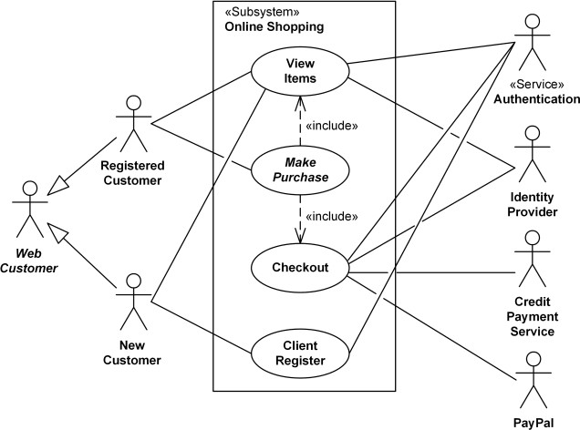
Source: uml- diagrams.org
Example: Use Case Diagram
8

Slide 9



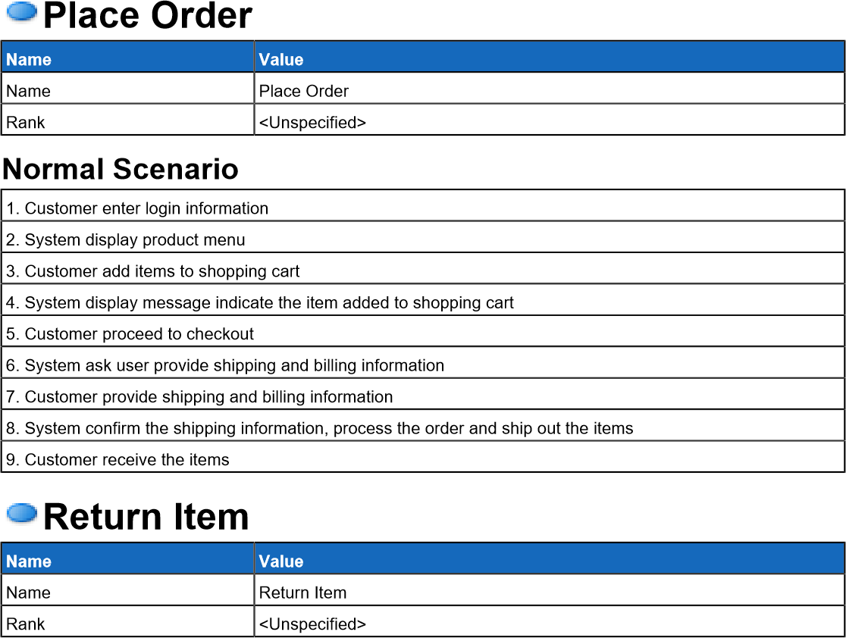

Source: visual- paradigm.com
Example Use Case: Shopping Cart
9

Slide 10
Functions and data are closely related and you can’t really describe one without the other.
The usual way to describe system data is in terms of (logical) data entities. An entity is a “thing” of interest (a customer, an address, an order, a product). Entities have attributes (a customer has a first name, a last name, a date of birth etc.). Entities also have relationships with one another (a customer has one or more delivery addresses; a customer has zero or more orders; an order consists of one or more products)
2) Data

Slide 11
There are 2 techniques that can be used to describe entities – Entity Relations Diagrams and/or Class Diagrams ER diagram (relationships): are primarily used to represent the relationships between different entities within a system (using primary key, foreign key, weak entity). They help to visualize how data is interconnected, which can inform decisions on data organization and flow. Class diagram (organisation/functions): describe the structure of a system by showing its classes and the relationships among them, such as attributes, types of attributes, method, the return type of methods, method's parameter, a relationship of a class(inheritance, aggregation etc.).
Data

Slide 12
Typical level of detail needed for data description in the Functional Spec:
Entity/Class name (so that it can be unambiguously referred to)
Entity/Class description (explaining what the entity actually is)
Attributes
Attribute Name
Attribute Description ( not always obvious)
Type and allowable values, such as:
String, max 50 characters
Integer from 0 to 60,000 or blank
Specific value – i.e. Male, Female or Not Specified
Relationships with other entities:
Meaning of relationship (e.g. home address, delivery address)
Multiplicity (one-to-one, one-to-many, etc.)
Data

Slide 13
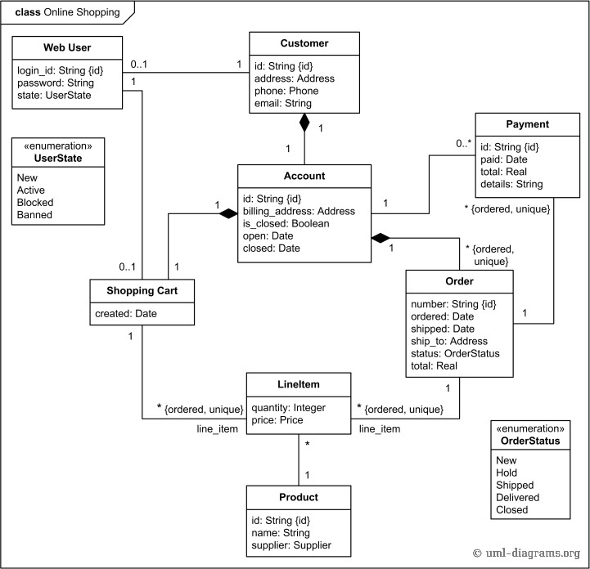
Source: uml- diagrams.org
Example Class Diagram: Online Shopping
16

Slide 14
In groups, what are the some of the entities/classes in a website of your choice? Then see if you can expand the level of detail to include:
Class Exercise
(10-15 Minutes)
Name
Description
Attributes
Relation to other entities

Slide 15
Read this example:
https://www.justinmind.com/blog/functional-specification-documentation-quick-guide-to-making-your-own/
Functional Specification
- Document
Templates
https://www.smartsheet.com/free-functional-specification-templates

Slide 16
UX Design - Scope
Source: Garrett, 2002
2

Slide 17
All web sites have content. So, it’s necessary to capture all the types of content that will be used on the site. For each type of content identify the following:
What is the purpose of the content? Is it related to any other content?
Who is the audience for this content?
Does it exist in web copy today?
Does it exist in some other format (i.e. Word, xls, PDF, graphic)?
Who owns it?
Who maintains and updates it? Is there any workflow associated with it?
How often is it updated?
Is this content static, or does it need to be available for only periods of time?
If the site is bilingual, is the content translated? Does it need to be?
Content Requirements

Slide 18
https://www.peachpit.com/articles/article.aspx?p=1681039
Jesse James Garrett on Content Requirements
Content Requirements focus on the purpose of the content not the format.

Slide 19
When evaluating content for websites, it is important to look at 5 aspects of that content, these are:
Accuracy of the content.
Who has Authority of the content.
The Objectivity of the content.
The Currency of the content.
What is the Coverage of the content.
Evaluating Content

Slide 20
Accuracy Are sources of information and factual data listed, and available for cross-checking
Check the content
for accuracy of spelling, grammar, facts(!), and consistency within website
Check content for a bibliographic
variety of websites (external links), of electronic media (electronic databases of references), established (print & on-line) journals, of electronic indexes (ERIC), and of books for comparative/evaluative purposes
•
Evaluating Content (1)
•

Slide 21
Authority
Who is responsible for the page?
Who published the document and is it separate from the "Webmaster?" What are their qualifications and associations, and can you verify them?
Check the domain of the document, what institution publishes this document?
Check the footer
for name of the web page author, his/her credentials and title, organisational affiliation. Is the information verifiable?
Evaluating Content (2)

Slide 22
Objectivity
Are biases clearly stated? Are affiliations clear?
Check the content
for statement of purpose, to determine the type of web site and potential audience
for external sites to gauge the quality and credibility of the information referenced outside the website.
for graphics and cues for affiliations
What goals/objectives does this page meet? How detailed is the information?
What opinions (if any) are expressed by the author?
Check the header/footer and URL/domain (.gov
.com .edu)
to determine organizational source of website and how this reflects on content type
Evaluating Content (3)

Slide 23
Currency
Are dates clear when the website was first created and edited?
Check the footer
for when the website was created, and when last edited.
Check the content
for news items, indications that the site is actively maintained, acknowledgements/responses to visitors
How up-to-date are the links (if any)?
Evaluating Content (4)

Slide 24
Coverage
What is the focus of the site? Are there clear headings to illustrate an outline of the content? Is the navigation within the website clear?
Check the header
for a clear title and web site description
Check the content
for headings and keywords
Is it all images or a balance of text and images?
Is the information presented cited correctly?
Check the navigation
to reflect content outline within the web site
Are the links (if any) evaluated and do they complement the documents' themes?
Evaluating Content (5)

Slide 25
Accuracy
Make sure author provides e-mail or a contact address/phone number.
Know the distinction between author and Webmaster.
Authority
What credentials are listed for the authors?
Where is the document published? Check URL domain.
Objectivity
Determine if page is a mask for advertising; if so information might be biased.
View any Web page as you would an infomercial on television. Ask yourself: why was this written and for whom?
Currency
How many dead links are on the page?
Are the links current or updated regularly?
Is the information on the page outdated?
Coverage
If page requires special software to view the information, how much are you missing if you don't have the software?
Is it free or is there a fee to obtain the information?
Is there an option for text only, or frames, or a suggested browser for better viewing?
Evaluating Content (6)

Slide 26
Content Audit is the process of creating and maintaining the content inventory.
http://uxmastery.com/how-to-conduct-a- content-audit/
Content Inventory
The key stages are:
Identify
Collect
Collate
Supplement

Slide 27
https://uxmastery.com/how-to-conduct-a-content-audit/
A content audit is usually a spreadsheet collecting all the relevant information, for each page that will be:
Navigation title: The name of the main navigation link to the content (e.g. the link title in the main navigation)
Page name: The displayed page title
URL: You may want to display the URL or just link from the page name
Comments: Notes and things for you to remember
Content hierarchy: Some way of showing the basic relationship of the content items
Content Audit

Slide 28
https://uxmastery.com/how-to-conduct-a-content-audit/
Things you also might also consider:
Content Type: Is this a basic page, publication, news story, article, technique, FAQ, or something else?
Basic content description: A brief reminder about what’s on the page
Topic, tags or category: Meta data for products, articles, news, blog posts
Author: Who wrote this content?
Owner: Who is responsible for the content?
Date last updated: When was the content last updated?
Attached files: How many files are attached, and what type of files are they?
Related: What information is linked from sidebars or Related Links boxes on this page?
Availability: Is the content available to desktop, mobile and/or app users? Is the content syndicated to other sites?
A numbering system: An index to help you when referring to each content item.
Content Audit

Slide 29
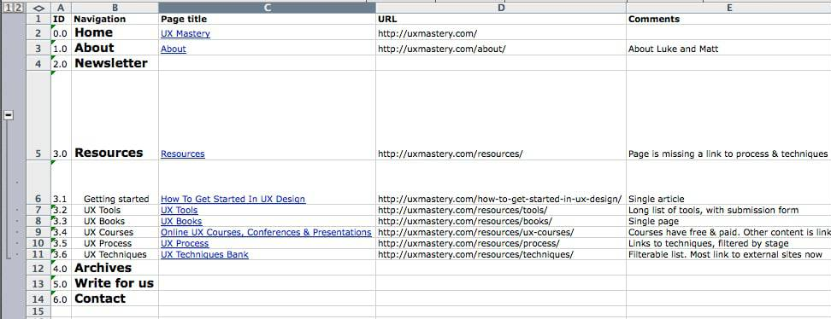
Source: https://uxmastery.com/how-to-conduct-a-content-audit/
Example Content Audit
16

Slide 30
Once you content has been collected and sorted then the decision on what to include needs to be made alongside their priorities.
Prioritising Content
The key decision is how the content will support the strategy and site objectives.
This should help identify a hierarchy of content.

Slide 31
Defining the scope of your project is both: a valuable process that results in a valuable product.
Summary
The result of a proper scope is: -
tells you, the client and the development team what you are building
Tells you, the client and the development team what you are not building

Slide 32
Joel Spolsky’s series of articles: Painless Functional Specifications – Part 4: Tips – Joel on Software
Further Reading
Writing a functional Spec:
What Goes Into a Functional Specification? (bridging-the-gap.com)

